Slide 1
OS history

Slide 2
Before OSes – 1950..
Earliest computers were mainframe comp. without an OS. Each user would solely use the comp. for a period of time and the comp. would run the program until completion or crash; debug using a control panel, switches and panel lights.
Users first wrote programs in machine code (on punched cards or tape)
When symbolic languages, assembler and compilers were available, users wrote programs in programming languages like Fortran; but had to add drivers for the specific architecture, for punch cards/tape reading/writing devices
Libraries containing IO drivers became available, so the program would be linked to these libraries

Slide 3
Before OSes – 1950..
4) Run queues with people waiting at the door in order to run a job on the computer
5) Later, an operator would send job to the computer, users would hand the program on punched cards to this operator
6) Run time of a program shortened (due to increase performance on the mainframe), so the delay caused by switching jobs became to high => run-time libraries, i.e. monitors were created that would clear the state of previous job, prepare and execute the next job, save the results, clear the state, take next job …
7) These monitors eventually turned into Oses.

Slide 4
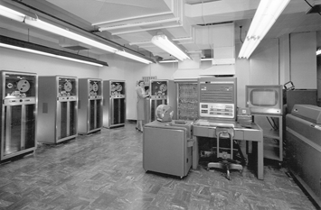
First OS - GM-NAA I/O, 1956
First OSes were developed by clients, not the manufacturers
GM-NAA I/O was developed by General Motors for their IBM 704 computer
Was formed from shared routines that provided common access to
IO devices; batch processing
Run on 40 computers

Slide 5
First Oses – 1950-1960
IBM OS/360, 1960s
Control Data Corporation developed Scope and MACE in 1960s or batch processing
Univac developed Exec I OS for their Univac 1107 in 1962; they followed with Exec II
Burroughs Corporation introduced the B5000 in 1961 with the MCP (Master Control Program) operating system - first OS written in a high-level program. lang., ESPOL
General Electric introduced General Electric Comprehensive Operating Supervisor (GECOS) operating system in 1962

Slide 6
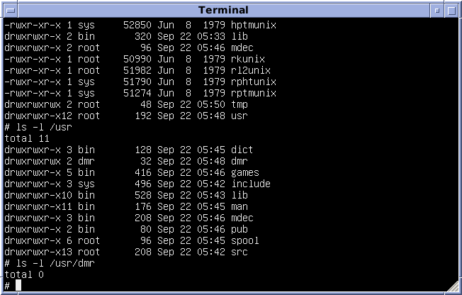
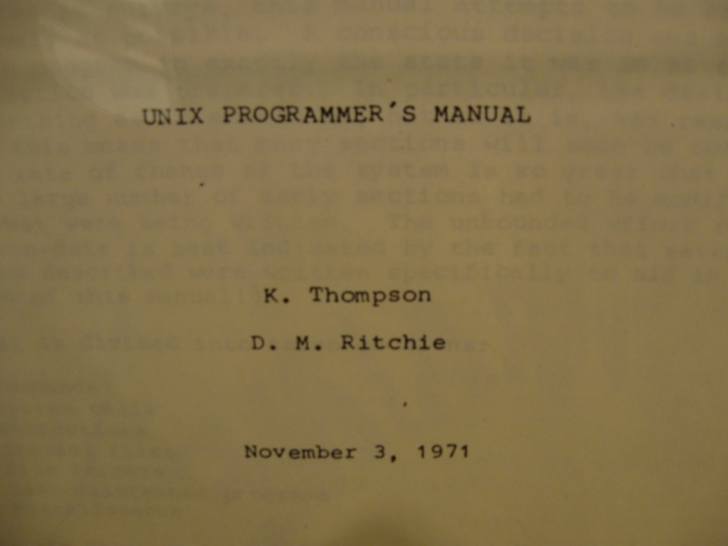
Unix, 1971

Slide 7
Unix
Development started in 1969 at Bell Labs by a team lead by Dennis Ritchie, Brian Kernighan and Ken Thompson
Name comes from Uniplexed Information and Computing Service
Developed on a PDP-11, based on Multics
First version (completed in 1971) was implemented entirely in assembly, but version 4 (1973) a large part was written in C
Is time-sharing, multi-user and multi-process (14 processes)

Slide 8
Unix
Design is modular, has a kernel and a shell containing commands; kernel is monolithical
Has an hierarchical file system unifying all components
Has IPC (semaphores), pipes
Introduced regular expressions
Free licensee and portability (impl. In C) added to its success
Lines of successors: AT&T (Unix Sys I/II/III/V), University of California, Berkeley (BSD), Microsoft (Xenix), IBM (AIX), and Sun Microsystems (Solaris)

Slide 9
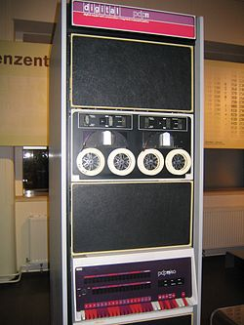
PDP-11, the computer on which Unix was developed

Slide 10
Unix successors
Original Unix (Bell labs)
1st edition, 1971
4th edition, 1973 (rewritten in C)
6th edition, 1975 (available outside Bell Labs)
7th edition, 1979 (had Bourne shell)
AT&T UNIX System Group (USG) family:
Unix System III, 1982 (first public release outside Bell labs)
Unix System V, 1983
Unix System V release 2, 1984 (100K instalations)
Unix System V release 3, 1987 (750K instalations)
Unix System V release 4, 1989 (1.2M instalations)
Unix System V release 5, 1998

Slide 11
Unix successors (cont.)
The Berkeley Software Distribution (BSD) family:
BSD 1, 1978
BSD 2, 1979
BSD 3, 1980
BSD 4.1, 1981
BSD 4.3, 1986
BSD 4.3 Tahoe, 1988
BSD 4.3 Reno, 1990
BSD 4.4, 1993
FreeBSD 1.0, 1993
BSD 4.4-Lite, 1993
NetBSD 0.8, 1992
OpenBSD 1.0, 1995
DragonFly BSD, 2005

Slide 12
Unix successors (cont.)
Sun Microsystem family: SunOS 1 (1982), SunOS 4 (1989), Solaris (1991) Solaris 11 (2016)
IBM AIX family: AIX 1 (1986)
Microsoft & SCO Unix Xenix family: 1980 – 1989
HP’s HP-UX family: 1986 – today
Apple family: NextSTEP (1989-1995), MacOS, iOS
Minix, 1987-2017, Andrew Tanenbaum
Linux, 1991 –
Android, Google, 2008 –
Plan 9 from Bell labs, successor of Unix, 1992-

Slide 13
UNIX standardization efforts
IEEE POSIX, 1988
Austin Group (IEEE, ISO JTC 1 SC22 and The Open Group) – Single UNIX Specification (1994)

Slide 14
Microsoft’s DOS (Disk Operating System), MS-DOS, PC-DOS
1980, IBM commissioned Microsoft (a garage company) to develop a new OS for their IBM-PC
Microsoft bought Tim Paterson’s 86-DOS (Quick and Dirty OS, based on 16 bit CP/M) and sold it to IBM
IBM found more than 300 bugs and re-wrote much of the code
1981, MS-DOS 1.0, PC-DOS 1.0
Had only 1 directory, the root dir., no subdirectories

Slide 15
MS-DOS history
1982: MS-DOS 1.25, PC-DOS 1.1
1983: MS-DOS 2.0, PC-DOS 2.0 (had UNIX style hierarchical directory structure)
1984: MS-DOS 3.0, PC-DOS 3.0 (supported larger HDDs and High Density 1.2MB 5” floppy disks)
1985: MS-DOS 3.1, PC-DOS 3.1 (network support); the Windows GUI was launched
1988: PC-DOS 4.0, MS-DOS 4.0 (version was not properly tested, caused many system crashes ; supported HDD up to 2 GB)
1990: Windows 3.0 released; very successful; multitasking
1991: MS-DOS 5.0, PC-DOS 5.0 (end of collaboration between Microsoft and IBM)
1993: MS-DOS 6.0
1993: Windows NT 3.1, the first release of the Windows NT (completely new kernel, not based on MS-DOS, very stable)

Slide 16
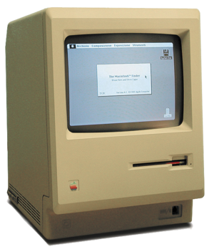
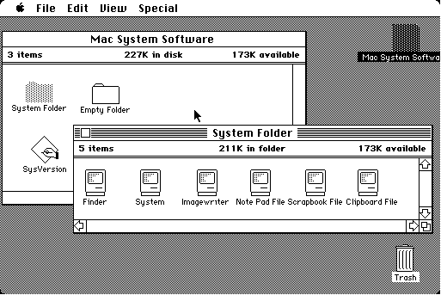
Macintosh System 1, 1984
Macintosh 128K

Slide 17
Macintosh System 1
First mass-market personal computer
OS had a GUI
Built-in monitor and mouse
In 1978 when working on Apple Lisa, Steve Jobs learned about the Graphical User Interfaces created by Xerox
Contained MacWrite and MacPaint

Slide 18
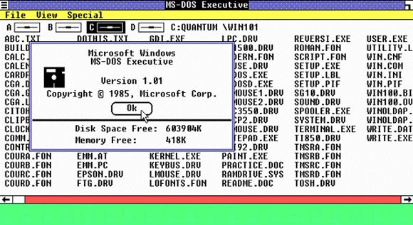
Windows 1.0, 1985

Slide 19
Windows 1.0
An extension of MS-DOS
Appeared 2 years after Apple’s MAC – Apple sued Microsoft for stealing their ideea
Couldn’t use overlapping windows and trash bin due to the legal issues with Apple

Slide 20
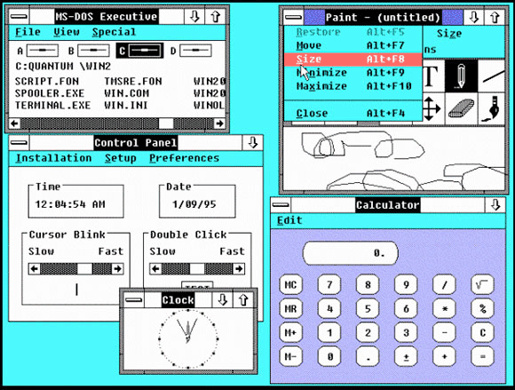

Slide 21
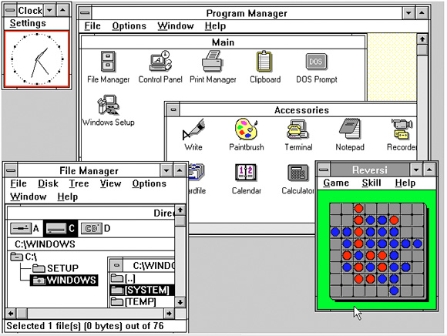
Windows 2.0, 1987

Slide 22
Windows 2.0
Had icons and overlapping windows
Had early versions of Word and Excel
Had Aldus PageMaker, a popular desktop-publishing program that had previously run only on the Mac
Also games

Slide 23
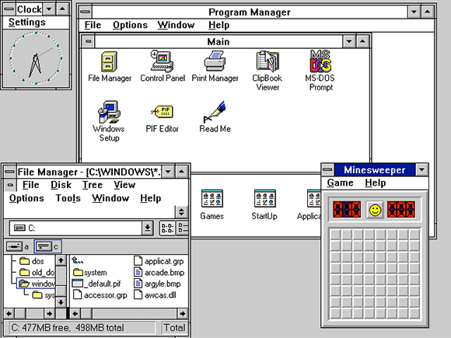
Windows 3.0, 1990

Slide 24
Windows 3.0
new file-management system and enhanced graphics finally made the Windows PC a competitor to the Mac
More efficient memory handling
Microsoft sold 10 million copies in two years
Developers began to write 3rd party software – which increased the popularity of the OS among consumers

Slide 25
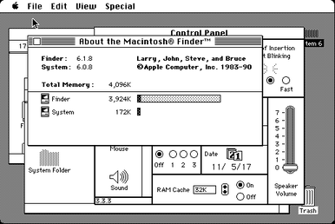
Macintosh System 6, 1991

Slide 26
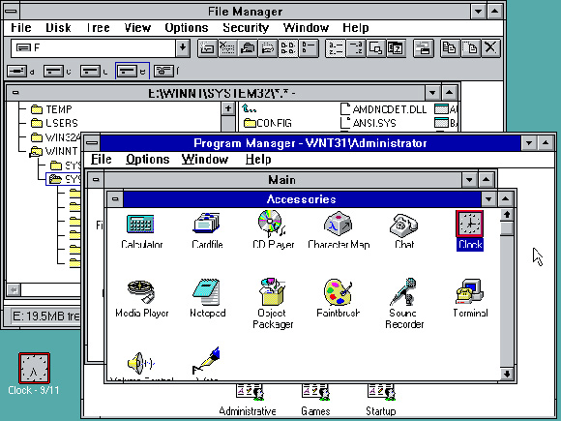
Windows 3.11, 1993
included support for TrueType scalable fonts, multimedia capabilities and Object Linking and Embedding

Slide 27
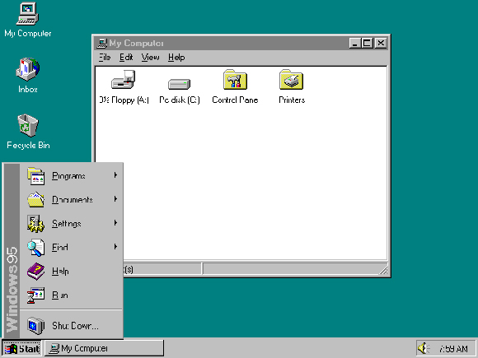
Windows NT 3.1, 1993
developed for businesses and engineers who needed more sophistication in their OS
was written for 32-bit processors

Slide 28
1960-1980: free software to closed-source software
Companies would sell hardware accompanied by bundled software free of charge
Software came in the form of source code
IBM implemented in 1983 an "object code only" policy, no longer distributing source code

Slide 29
The Free Software movement, FSF, GNU Manifesto, 1985
Introduced by Richard Matthew Stallman (rms) in 1985 in the GNU Manifesto
Free software should respect the four essential freedoms:
The freedom to run the program as you wish, for any purpose (freedom 0).
The freedom to study how the program works, and change it so it does your computing as you wish (freedom 1). Access to the source code is a precondition for this.
The freedom to redistribute copies so you can help others (freedom 2).
The freedom to distribute copies of your modified versions to others (freedom 3). By doing this you can give the whole community a chance to benefit from your changes. Access to the source code is a precondition for this.

Slide 30
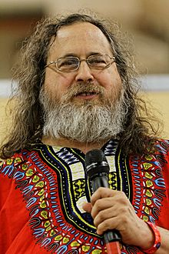
Richard Matthew Stallman (rms)

Slide 31
The Open Source Initiative, 1998
Founded by Bruce Perens and Eric Raymond in 1998
The convinced Netscape to release the source code of their browser
An open-source software should comply to (full description here: https://en.wikipedia.org/wiki/The_Open_Source_Definition):
Free Redistribution
Include Source Code
Allow modifications and derived work
Integrity of The Author's Source Code
No Discrimination Against Persons or Groups
No Discrimination Against Fields of Endeavor
Distribution of License
License Must Not Be Specific to a Product
License Must Not Restrict Other Software
License Must Be Technology-Neutral

Slide 32

Linux, 1992-1994
1991: Linux is born with the following post to the Usenet Newsgroup comp.os.minix: “Hello everybody out there using minix- I'm doing a (free) operating system (just a hobby, won't be big and professional like gnu) for 386(486) AT clones.”

Slide 33
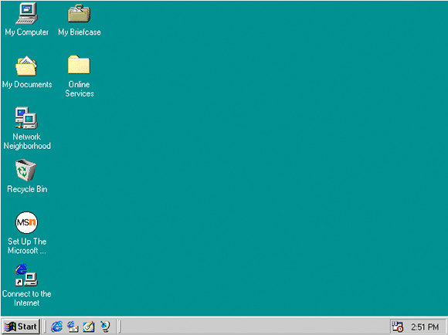
Windows 95, 1995

Slide 34
Windows 95
Brought computing to the masses
First full-fledged Microsoft Operating System
Had Internet Explorer, taskbar and the Start button
Started the everlasting battle of Microsoft with backward compatibility (some code parts ran in 32-bit mode, other in 16-bit mode)

Slide 35
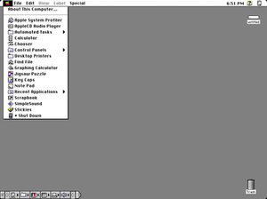
Macintosh System 7, 1997

Slide 36
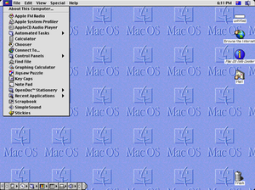
Macintosh System 8, 1997

Slide 37
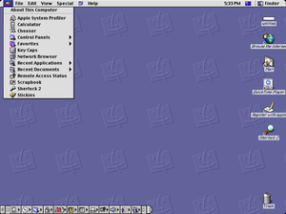
Macintosh System 9, 1999

Slide 38
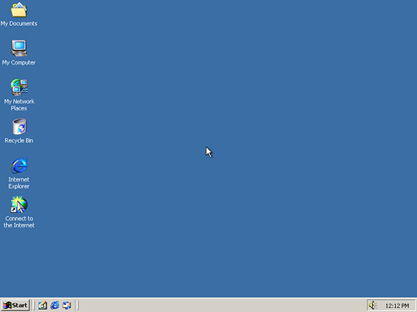
Windows 98, 1998
New FAT32 file system, Internet connection sharing, better IE

Slide 39
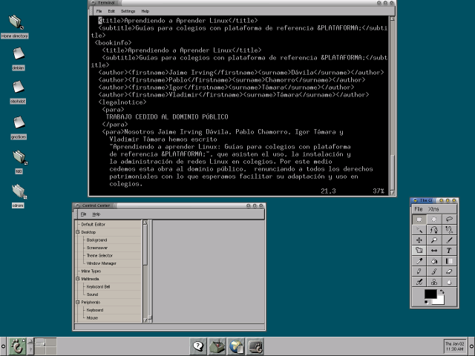
Linux+Gnome, 1999

Slide 40
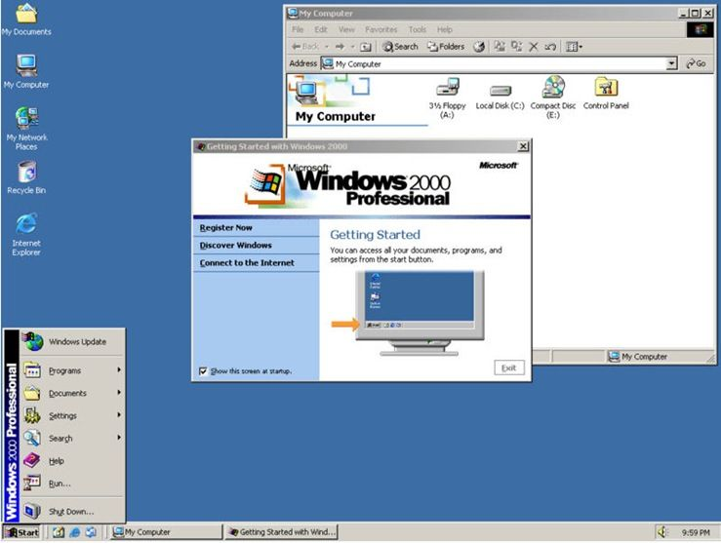
Windows 2000

Slide 41
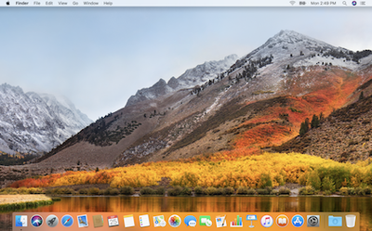
Mac OS X, 2001

